Slide 1
Implementation of the Recovery Curriculum

Slide 2
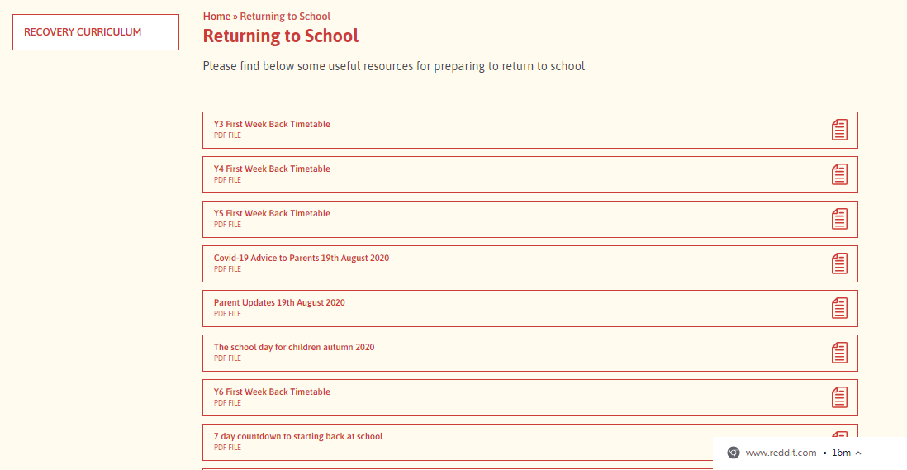
Returning to School Tab

Slide 3
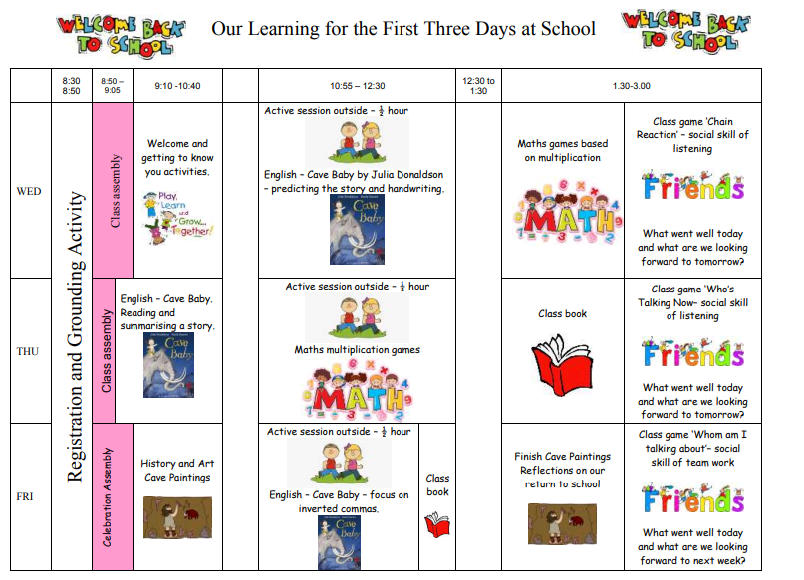
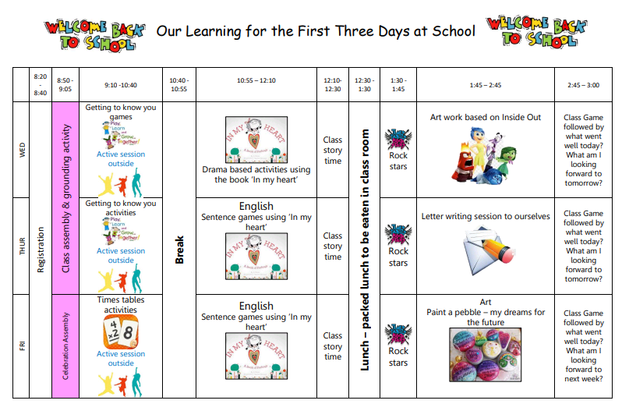
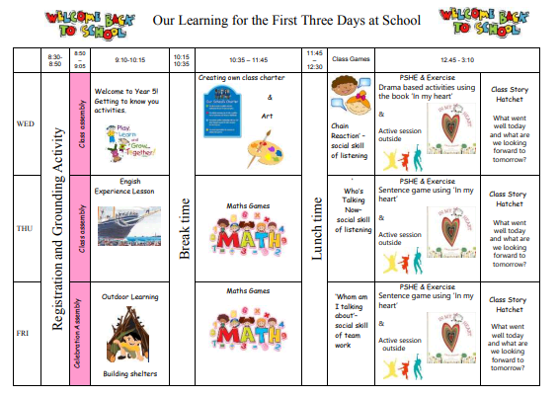
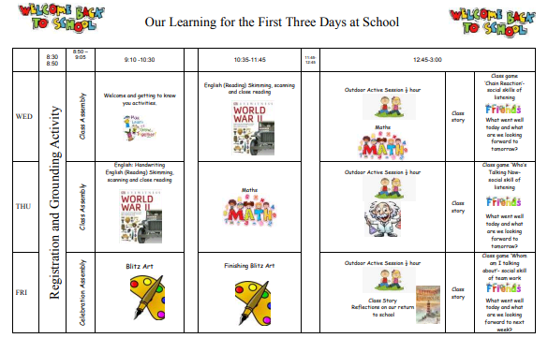

Slide 4
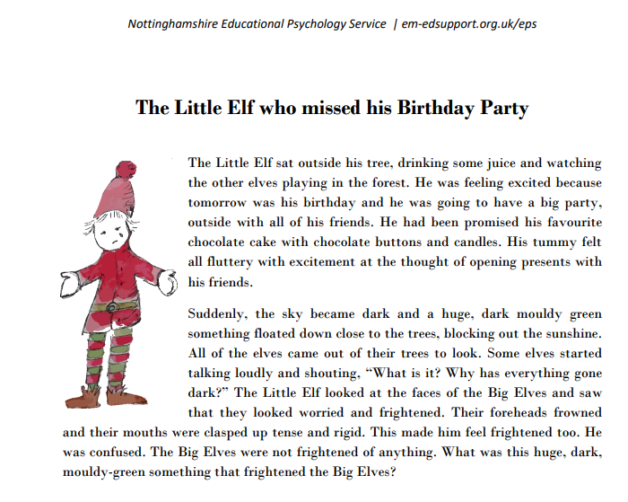

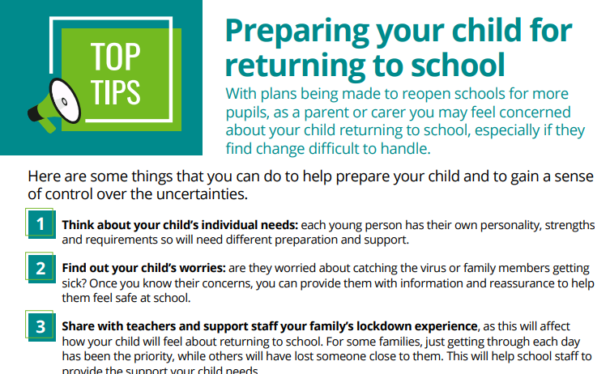

Slide 5
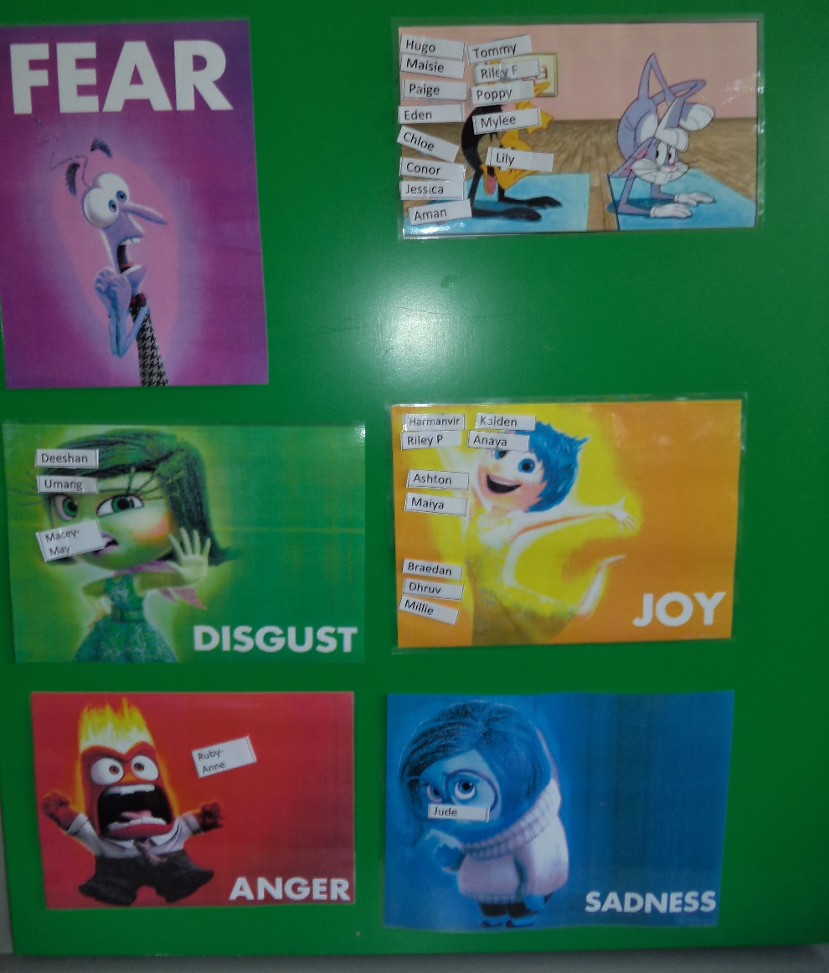
Assessing their feelings
Who’s driving you today?
Blob Tree assessment

Slide 6
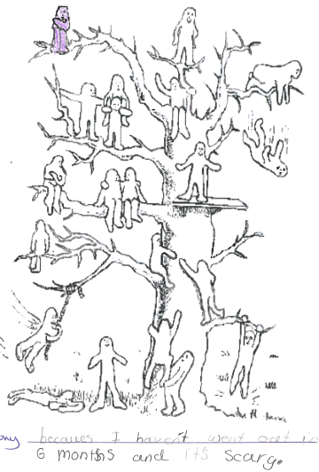
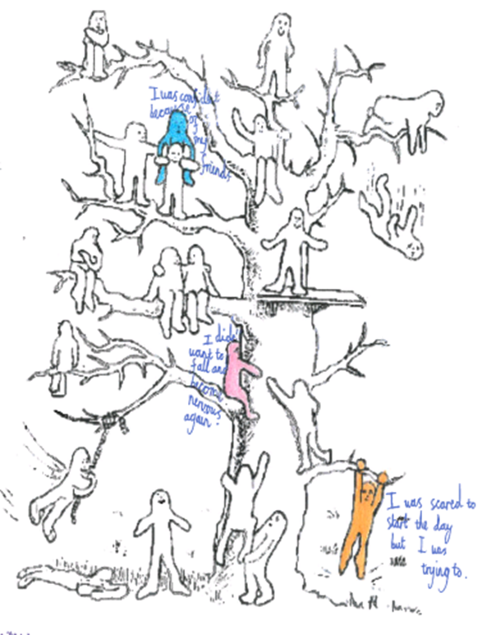

Slide 7
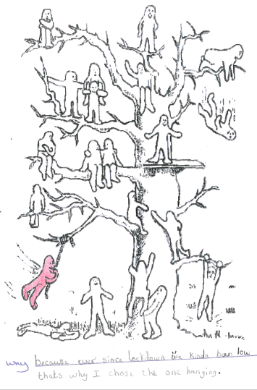
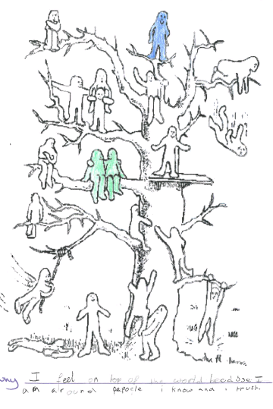

Slide 8
Blob Tree Assessment analysis
Year 6 58% positive (37% made reference to friends) 42% negative
Year 5 78% positive (44% made reference to friends) 22% negative
Year 4 71% positive (39% made reference to friends) 29% negative
Year 6 87% positive (48% made reference to friends) 13% negative
Pastoral support TA in each year group to help with those children identified as being very anxious or negative. Terri Stirk to offer more intensive support where needed. Boxall profiles used for those children we are very concered about.

Slide 9
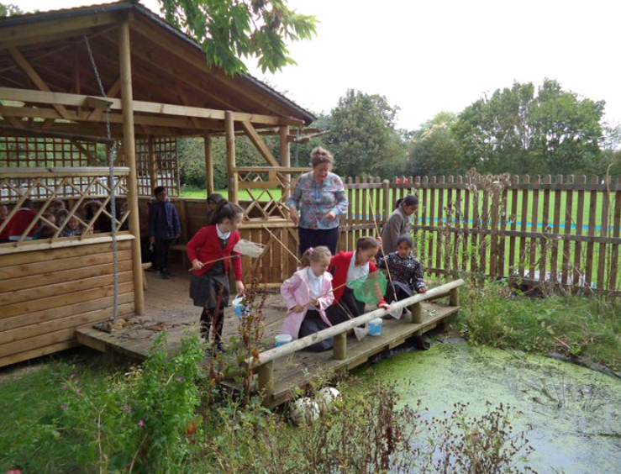
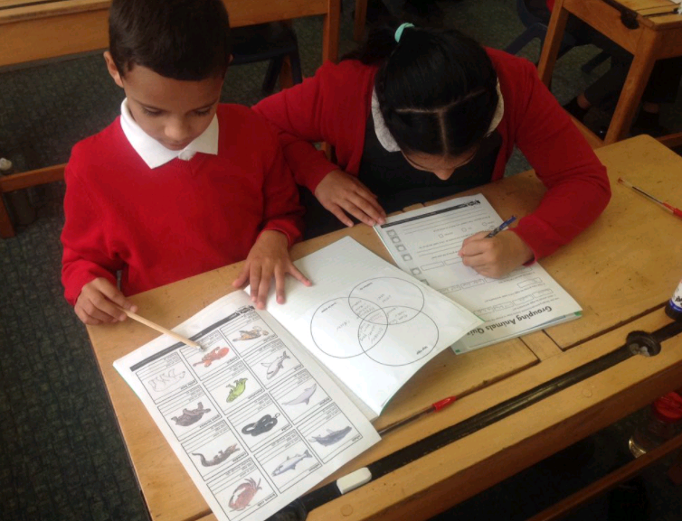
Curriculum Coverage – Science Day

Slide 10
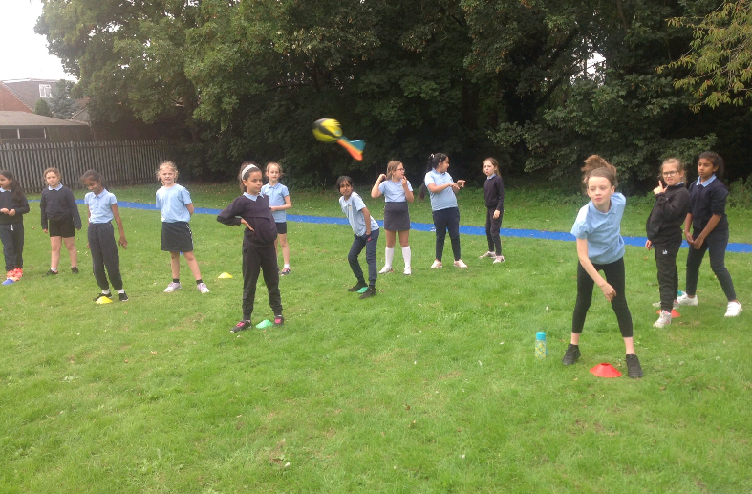
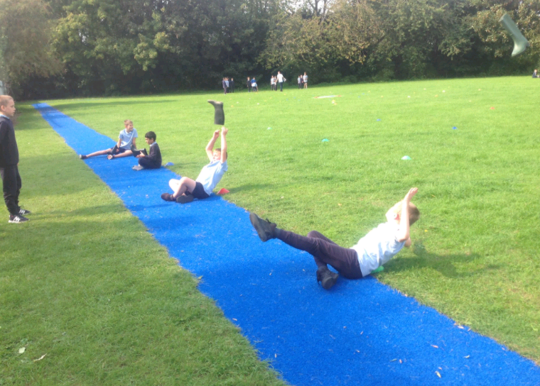
Sports Day

Slide 11
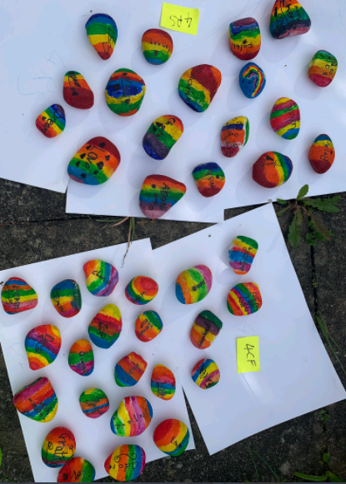
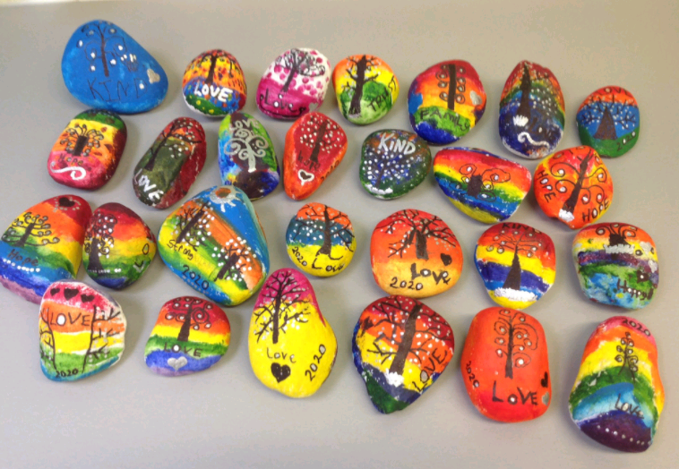
Pebble Mosaic

Slide 12
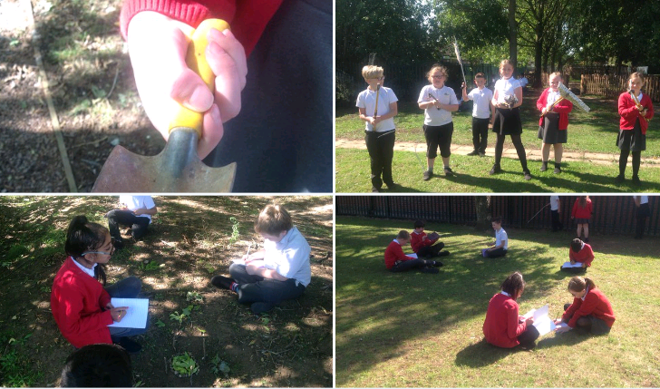
Outdoor Learning

Slide 13
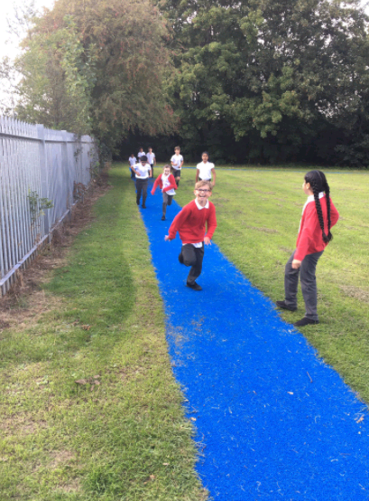
Half an Hour Activity

Slide 14
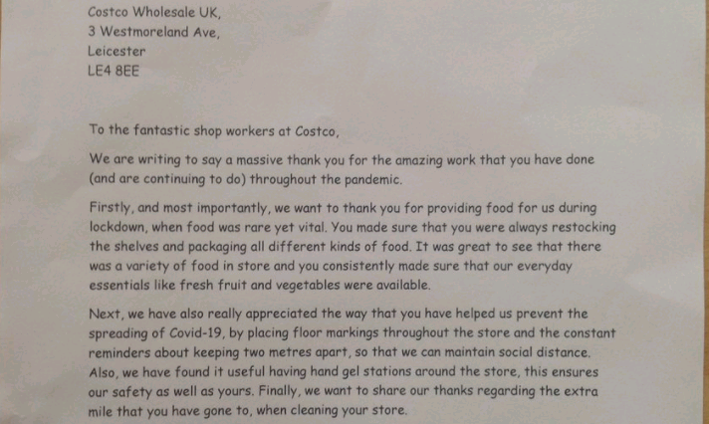
Letters to Key Workers

Slide 15


