Slide 1

Pupil Premium 2023-2024
Impact Analysis
“For the toughest problems, there are no quick fixes. But used with care and commitment, the Pupil Premium is one of the best bets we have.”
Sir Kevin Collins, CEO EEF
Manisha Sudera
Deputy Headteacher
July 2024
Notes:
done

Slide 2

Notes:
done

Slide 3
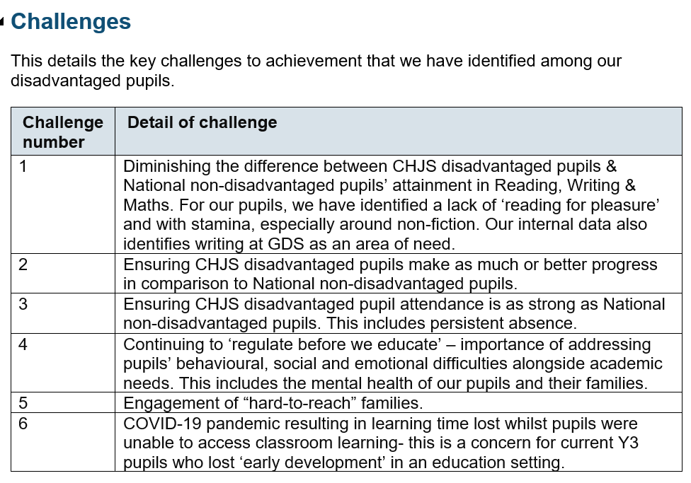
Notes:
done

Slide 4
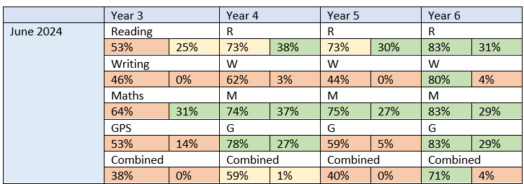
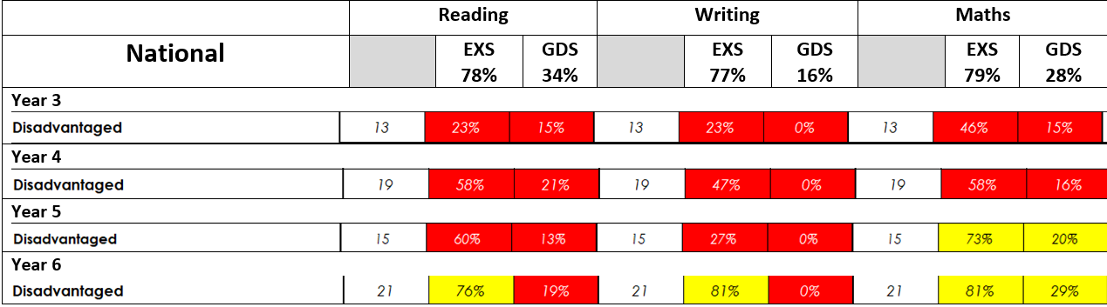
Tier 1: Teaching
Writing inset + coaching
Oxford Reading Buddy
Maths resources: TTRS, Testbase + White Rose
Online Learning
Favourite subjects:
Maths #1/14
Writing #4/14
Internal Data
Teaching & books are good across the school

Slide 5
End of KS2 Data 2024 (Provisional)
CHJS Vs Nat 2024
Reading: EXS 78% vs 74%/ GDS 26% + SS 105 vs 105
Writing: EXS 81% vs 72% / GDS 6%
GPS: EXS 88% vs 72% / GDS 36% + SS 107 vs 105
Maths: EXS 79% vs 73% / GDS 21% + SS 104 vs 104
Combined: EXS 69% vs 61% / GDS 4%
Science: EXS 90% vs 81%
CHJS PP 2024. National others TBC
Reading: EXS 14/19 (74%) GDS 5/19 (26%)
Writing: EXS 15/19 (79%) GDS 1/19 (5%)
GPS: EXS 14/19 (74%) GDS 5/19 (26%)
Maths: EXS 13/19 (68%) GDS 3/19 (16%)
NB 5/19 (26%) pupils are on the SEND register

Slide 6
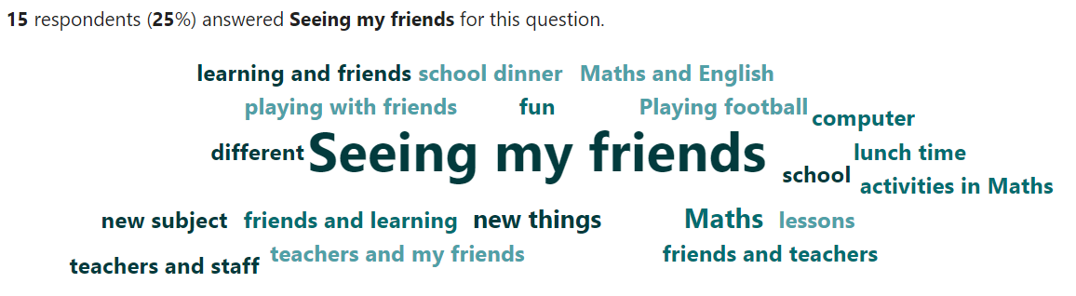
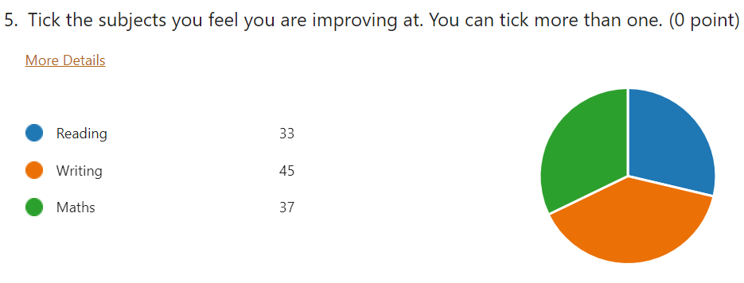
So what do our PP pupils have to say about school?
87% of pupils said they enjoy school
Maths, Art & PE were their favourite subjects
Most pupils felt they were making progress across RWM- most in Writing
Pupils value the support they get in the classroom most, particularly within small groups
Notes:
done

Slide 7
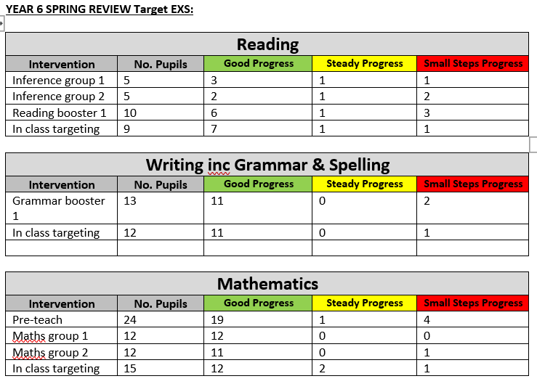
Tier 2: Targeted Academic Support
Increased support staff
Interventions
School Led Tutoring subsidy

Slide 8
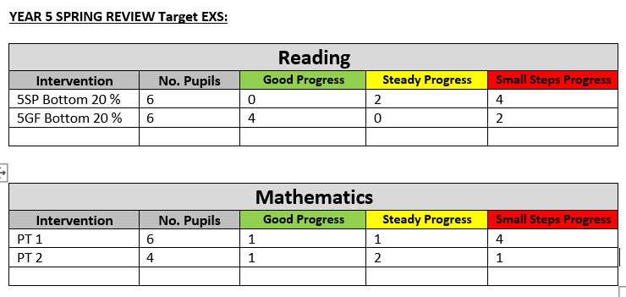
Tier 2: Targeted Academic Support
Increased support staff
Interventions
School Led Tutoring subsidy

Slide 9
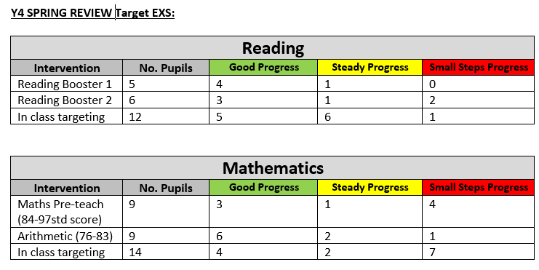
Tier 2: Targeted Academic Support
Increased support staff
Interventions
School Led Tutoring subsidy

Slide 10
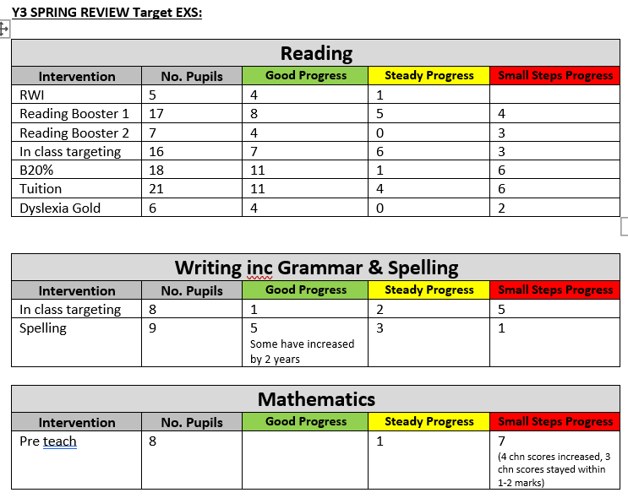
Tier 2: Targeted Academic Support
Increased support staff
Interventions
School Led Tutoring subsidy

Slide 11
School-Led Tutoring Impact
Autumn – Spring tutoring:
Y3 Phonics (TU10AA): 100% moved from set 2 to set 3 sounds
Y3 Reading (TU9AA): 5/5 pupils improved scaled score, some considerably
Y3 Reading (TU4MP): 3/5 improved scaled score
Y3 Reading (TU1MP): 3/6 improved scaled score
Y3 Reading (TU2MP): 3/4 improved scaled score
Y3 Maths (TU5MP): 2/6 improved scaled score
Y3 Maths (TU6MP): 1/6 improved scaled score
Y4 Maths (TU7AA): 5/6 improved their arithmetic improved score
Y4 Maths (TU8AA): 4/6 improved arithmetic score, 2/6 maintained score
Y4 Reading (TU3MP): 3/4 improved scaled score
“Friday extra maths boosts my confidence”
Notes:
done

Slide 12
School-Led Tutoring Impact
Summer tutoring:
Y3 Maths (TU1MP) 7/7 improved scaled score with 6/7 now at EXS
Y4 Maths (TU2MP) 2/7 made progress with 3/7 now at EXS
Y4 Grammar (TU20AA) 5/6 now at EXS compared to 1/6 in Autumn
Y5 Reading (TU15AA) 5/5 improved scaled score
Y5 Reading (TU21AA) 4/6 improved scaled score
“Mrs Pearson's Comprehension group has helped my learning”
Notes:
update

Slide 13
Tier 3: Wider Strategies
Pastoral Team
Attendance Support
Life Enrichment
Homework Club
Parental Support
Fiver Challenge
2023-2024 | Number of Incidents | CHJS PP | CHJS Non PP
Exclusion | 6 | 3 (50%) | 3 (50%)
3 Warnings Letters | 107 | 15 (14%) | 92 (86%)
Racist Incidents | 5 | 3 (60%) | 2 (40%)
Homophobic Incidents | 6 | 3 (50%) | 3 (50%)
Bullying | 1 | 1 (100%) | 0 (0%)

Slide 14
We asked, ‘Do you attend any school clubs?’
Mr Elliot has helped me during military drumming, increasing my timing and co-operation.
Choir | Football | Homework | Multi-sports | Radio
Military Drumming | Steel Pans | Art | Archery | Football
Chess | Rocksteady | Dodgeball
Homework Club: I never did my homework because I found it hard. Mrs C said I could go to her club and I love it because its fun and she helps me a lot. She makes sure I do everything I need to to not stay in at break. I don’t always get everything done but do some at home.
Choir: I love how even if I had a bad day I can just sing
Mr Partner has helped with my running.
Lewis in Rocksteady has be great
Notes:
done

Slide 15
Overall, 75 club places were attended by PP children this year with Gymnastics and Cookery proving popular.
Homework club has ran successfully all year. Around 40% of these pupils were PP however this fluctuates.
Enterprise Challenge: Y6 pupils made over £1400 profit between them. The business with the highest earnings made over £100 profit.
£6,727.02 was used to ensure PP children had uniform, attended trips, had cool milk and family support e.g. SATs books, swim caps, bereavement gifts.
15 families benefited from Easter hampers (food staples, sweet treats, crafts & games, Easter roast).
3 families benefit from food parcels.
Notes:
Update figures

Slide 16
When asked, ‘How do you think the school helps you/ your family?’ the following comments were made:
They help with a lot of things like behaviour
In my family we receive food packages from the school.
My parents are divorced so pastoral really helps me
It lets my mum have time to relax or do some work
Talk to me about my feelings
Tell parents when I learn new things
Sorting me out if I forget my packed lunch
School have helped with my anxiety
Tell parents when I learn new things
By giving us use of Parentpay
To have school trips to discover places I don’t know
Notes:
done

Slide 17
I’m safe at school
Notes:
done

Slide 18
Attendance
 | National 2023-24 | CHJS 2023-2024 PP | CHJS 2023-2024 Non PP
Absence | 94.2% | 92.9% | 95.3%
Persistent Absence | 16.9% | 26.4% | 11.2%
Notes:
update

Slide 19


Blue Sky Thinking- Vision
3 Year Strategic Plan 2024- 2027
Strategy Statement 2024-2025
Tiered Approach
Teaching
Targeted academic support
Wider strategies
Key Principles
Schools can make a difference
Evidence can help
Quality teaching helps every child
Support middle and high attainers too
Implementation matters- less is more

